Slide 1

FEDERATION OF FRENCH COASTAL SHIPOWNERS
French Coastal Shipowners
The federation of French coastal shipping companies
Since 1951, the Group has united and represented the shipowners who connect territories, islands and people, from mainland France to the overseas territories.
Since 1951
From mainland France to the overseas territories. Locally rooted. Socially committed.

Slide 2
Our purpose
Citizens' first link to the sea
Coastal shipping companies are citizens' first link to the sea and the maritime world.
Every day, hundreds of thousands of French citizens use coastal links to work, seek care, study and live. These lifelines connect the islands to the mainland, cross the estuaries and ensure territorial continuity, from mainland France to the overseas territories.
They are operated by local companies under the French flag. The Group is their collective voice and the leading maritime passenger carrier on the French coast.

Slide 3
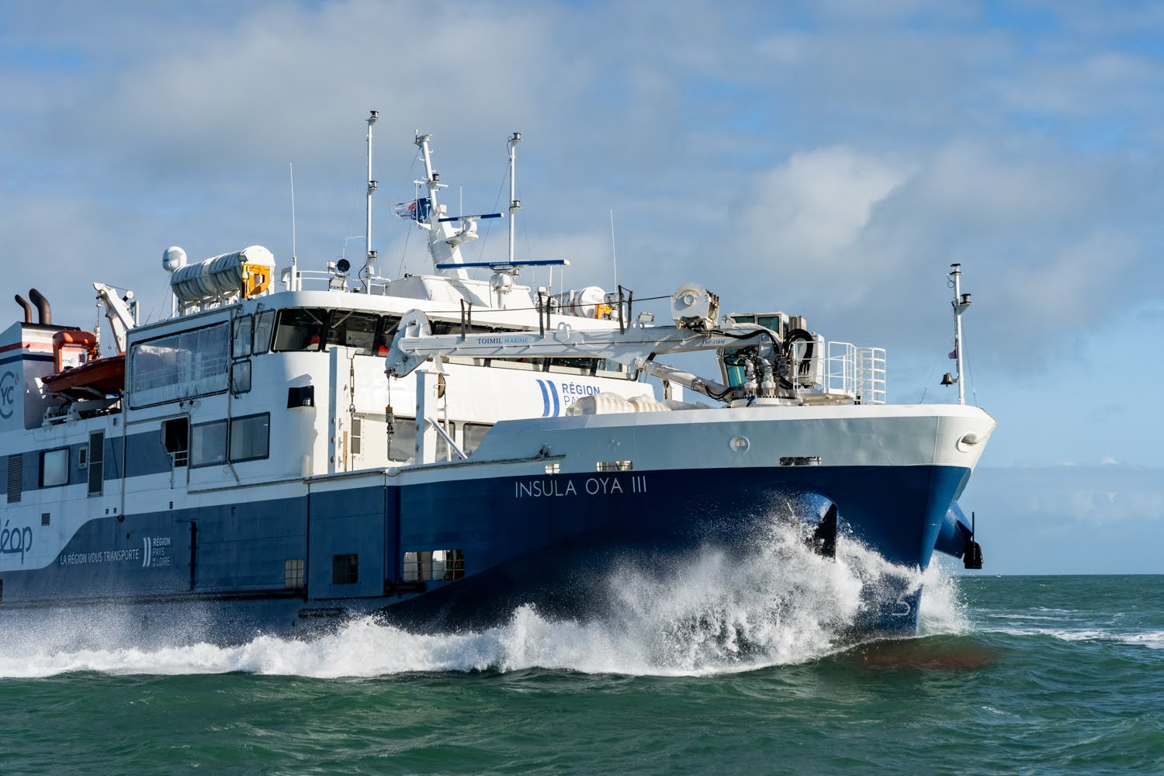
ON THE GROUND
Women and men who connect the territories
Photo · Thomas Jouanneau

Slide 4
The Group in numbers
A collective of national scale
31
429
2,437
shipowner companies
vessels under the French flag
French seafarers
31.3 M
6.9 M
~€193 M
passengers per year
vehicles carried / year
combined revenue
41 members in total, including 31 shipowner companies. Source: armateurscotiers.fr, August 2026.

Slide 5
Governance
Governance in three colleges
COLLEGE A
COLLEGE B
COLLEGE C
Public service operators
Private operators
Experts and authorities
26
6
9
public service operators
private operators
experts and local authorities
DSP · DIRECT OPERATION · PUBLIC CONTRACT · PSO
WITHOUT PUBLIC SERVICE MANDATE
PARTNERS AND INSTITUTIONS
Maritime public service in the broad sense
Network and working groups
Vessels operated on a strictly private basis
Coastal navigation, mainland and overseas
Experts, suppliers, institutions
Owner authorities that do not operate
Deliberative vote · min. 2 seats on the Board
Deliberative vote · min. 1 seat on the Board
Advisory vote at the General Assembly
SOCIAL COLLEGE (cross-cutting) · members employing seafarers under CCN 3228 appoint the employer delegates to the CPPNI and vote on social negotiation mandates, whatever their college.

Slide 6
Why join
What the Group brings to its members
1
Influence with public authorities
2
A structured social framework
3
Regulatory advice
Representation before administrations, local authorities and government.
CCN 3228: annual wage negotiations, pay scale, employee benefits.
Legislative monitoring, legal support, peer expertise.
4
Professional network and services
5
Collective employer brand
6
Energy transition
Working groups, events, experience sharing and services at preferential rates.
Partnerships with training centers, jobs portal, promotion of maritime careers.
Alternative propulsion, collective decarbonization of the fleet.

Slide 7
CCN 3228
The collective agreement of coastal shipping
Extended by ministerial order in 2021, it covers all seafaring staff on France's water crossings and island services. The Group is its employer signatory.
1
2
Wage negotiations concluded every year
Transparent pay scale
Steady improvement of working and pay conditions.
From deckhand to captain, rewarding experience and qualifications.
3
4
Recognized social dialogue
Equal access to employment
Legitimate counterpart to the sector's trade unions.
Diversity, training, career bridges.

Slide 8
Ecological transition
Charting the decarbonization of coastal shipping
Hybrid vessels, fully electric propulsion on urban links, accelerated fleet renewal: the Group's companies are pioneers.
90 %
42
~€20 M
of vessels built in France
vessels in the renewal plan by 2040
in maintenance in France per year

Slide 9
Testimonials
In our members' words
“
“
The Group allows me to stay constantly abreast of regulations and to benefit from a public relations service equivalent to that of a large maritime group.
For nearly 75 years, the Group has steadfastly defended the interests of coastal shipping companies. Our ambition is to strengthen our institutional presence and our operational effectiveness.
Nelly Depardieu
Baudouin Pappens
Director · Manche Îles Express · Secretary of the Group
CEO · Compagnie Yeu Continent · President of the Group

Slide 10

Let's build the future of French coastal shipping together
Join the companies that, together, make the voice of the coast heard, from mainland France to the overseas territories.
Colomban · General Delegate
colomban@gaspe.fr · www.armateurscotiers.fr
Maison de la Mer, 55 Quai de la Fosse, 44000 Nantes
From mainland France to the overseas territories. Locally rooted. Socially committed.

